Slide 1

Numerical approach to analyse physical system
Industrial training (7PH192)
By SHASHI KUMAR SAMDARSHI
Roll No: 1510002 Under the guidance of Dr. Anurag Sahay Department of Physics National Institute of Technology Patna

Slide 2
Outlines
Introduction to Euler’s method, Euler-Cromer method
Physical system
Summary
References

Slide 3
Euler’s method and Euler-Cromer method
Euler’s method is a numerical method to solve first order differential equation with given initial value. There is a problem with Euler’s method for oscillatory motion who solved it is Cromer.

Slide 4
Physical system
Simple pendulum ,with damping and with damping and forcing
Simple pendulum
The swinging of a pendulum is governed by the equation
d² x/dt²+ (g/L) sin(x)=0
x=theta, y=omega
Euler scheme
(i) Plot of x versus time (using Euler scheme)
Euler-Cromer scheme
(ii) Plot of x versus time (iii) Plot of x versus y
With dmping
d² x/dt²+ (g/L) sin(x)+ß*dx/dt=0
ß=damping parameter
(iv) Plot of theta versus time (v) Plot of Omega versus time
With damping and driving force
d² x/dt²+ (g/L) sin(x)+ß*dx/dt=Acos(wt)
(vi) Plot of theta versus time

Slide 5
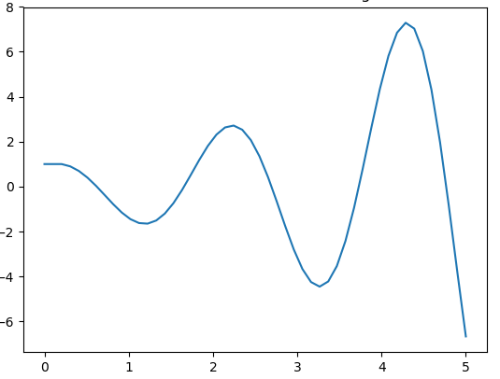
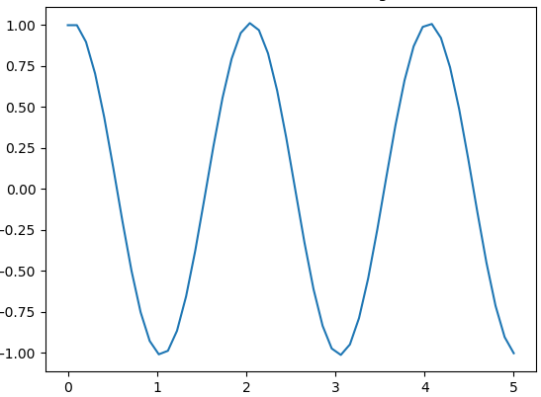
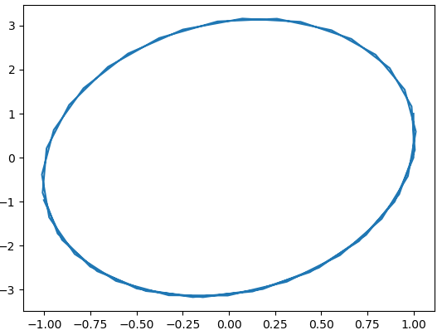
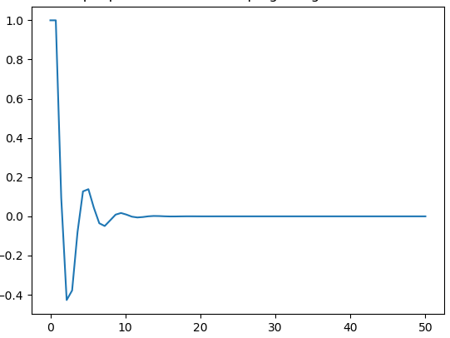
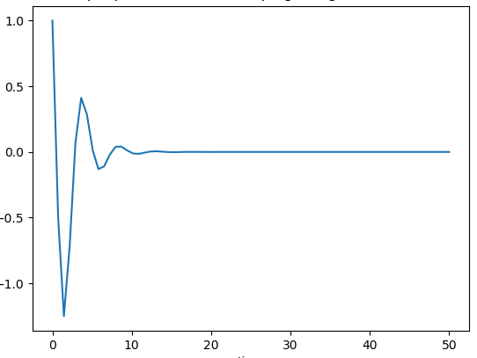
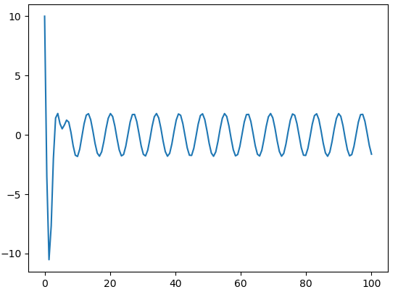
Theta
Theta
Theta
Time
Time
Omega
(i)
(ii)
(iii)
Theta
Omega
Theta
Time
Time
Time
(iV)
(v)
(vi)

Slide 6
Summary
For any oscillatory motion , the energy of Euler’s solution increases with time.
Problem with Euler’s solution is fixed by Cromer by the position x_{i} and velocity v_{i} at step i to find the position x_{i+1}.

Slide 7
References
Rubin H. Landau Manuel J. Paez Cristian C. Bordeianu Computational Physics
E. Ward Cheney, David R. Kincaid Numerical Mathematics and Computing, Sixth Edition
S S SASTRY Introductory methods of numerical analysis
Paul L DeVries A first course in computational physics
Steven E. Koonin Computational physics,

Slide 8
Code
import numpy as np
from matplotlib import pyplot as plt
l=1,g=1,t0=0,x0=1,y0=1,tf=5,n=50
deltat=(tf-t0)/(n-1)
t=np.linspace(t0,tf,n)
y=np.zeros([n])
y[0]=y0
x=np.zeros([n])
x[0]=x0
for i in range(1,n):
y[i]=y[i-1]+deltat*x[i] #y=theta
for i in range(1,n):
x[i]=x[i-1]-(g/l)*y[i-1] #x=omega
for i in range(n):
for i in range(n):
print(y[i],x[i])
plt.xlabel("time")
plt.ylabel("omega")
plt.plot(t,x)
plt.show()

Slide 9
Thank you!

